Slide 1
PROMIS 2nd workshop “Modelling and design Photonics” Cadiz 18-20 May 2016
PhD student: Flavio Nucciarelli

Slide 2
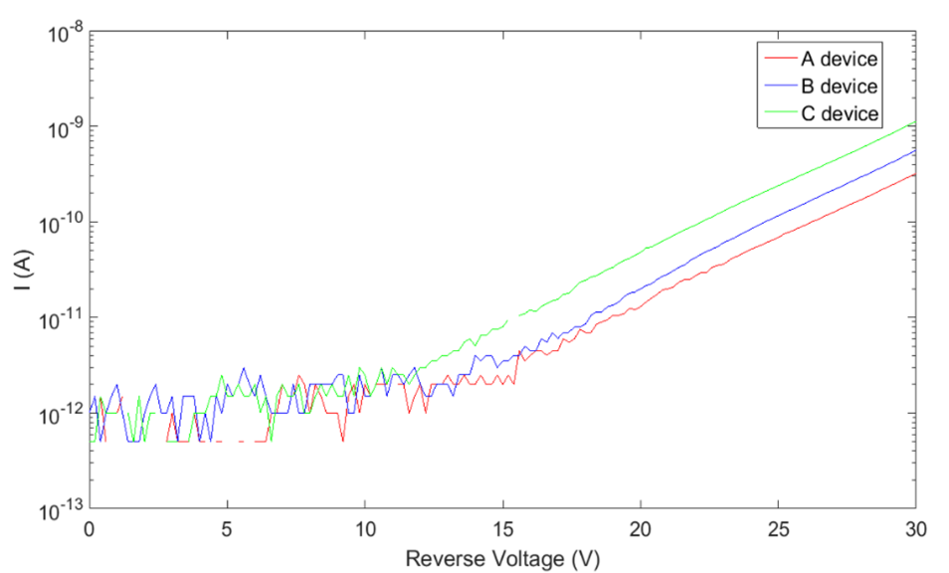
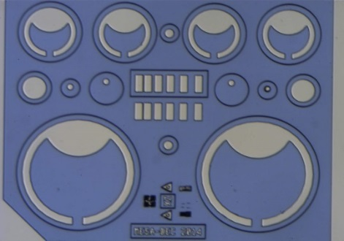
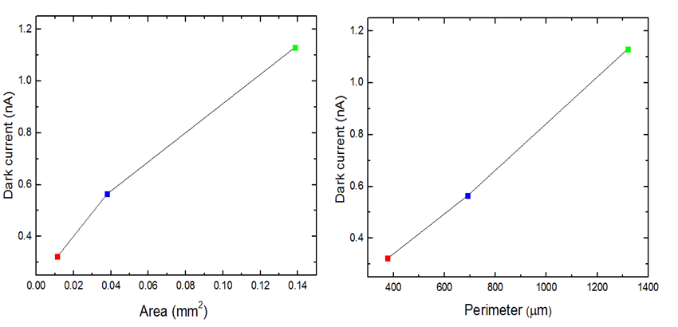
Plasmonic for APD sensor
Sheffiled APD
Colloidal Ga NPs
NPs effect on APD
Plasmonic lens
Characterization of APD devices suplied by
Sheffield University
B
A
C
We characterize the dark current of InGaAs/InAlAs APD devices supplied by Sheffiled university
It was observed how sidewalls leakage may be the most significant contribution to the dark current level in the devices
Fig: ID trend related to sensors area and perimeter

Slide 3
Plasmonic for APD sensor
Sheffiled APD
Colloidal Ga NPs
NPs effect on APD
Plasmonic lens
Gallium nanoparticles colloidal
synthesis and investigation
Silicon substrate
Sputtering
deposition
Galium
Evaporation
or
AZO layer
AZO layer
Glass substrate
Sub
Sub
AZO
attack (40’’)
+
Water wash (10’)
Drop casting
(1day)
Ga NPs
colloidal solution
Ultrasonication of
1.5 mL of solvent
Sub

Slide 4
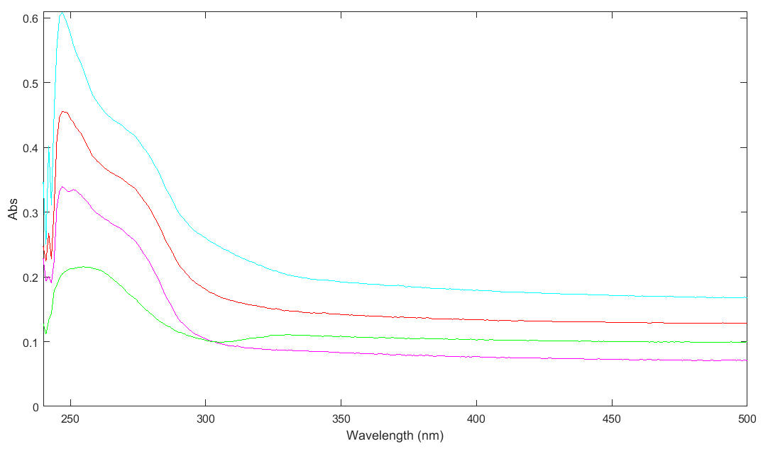
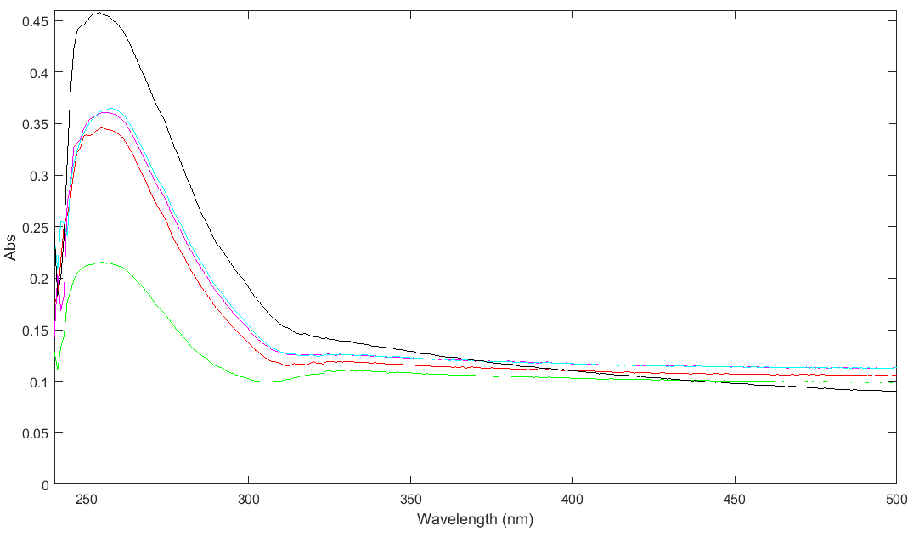
Plasmonic for APD sensor
Sheffiled APD
Colloidal Ga NPs
NPs effect on APD
Plasmonic lens
Gallium nanoparticles colloidal
synthesis and investigation
Water case
We characterize the Ga NPs Abs spectrum by UV spectrophotometer
A significant absorption change was observe related to the pH value of the aqueous colloidal solution: for high acid or basic pH value of the solution, nanoparticles are less agglomerated

Slide 5
Plasmonic for APD sensor
Sheffiled APD
Colloidal Ga NPs
NPs effect on APD
Plasmonic lens
Fabrication of patterns for selective NPs
evaporation on APD stuctures
Figure : (1) NPs on top active area (2) NPs on sidewalls area
Contact
Ga Nanoparticles
Passivation layer

Slide 6
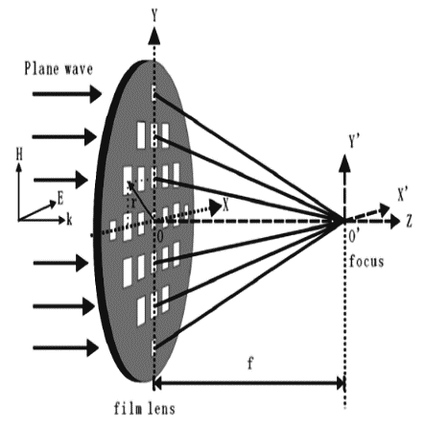
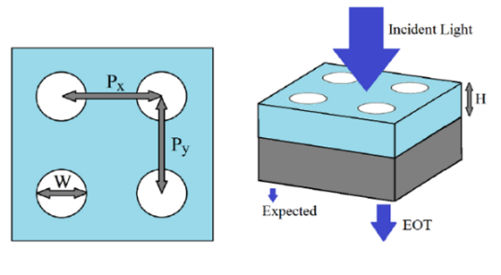
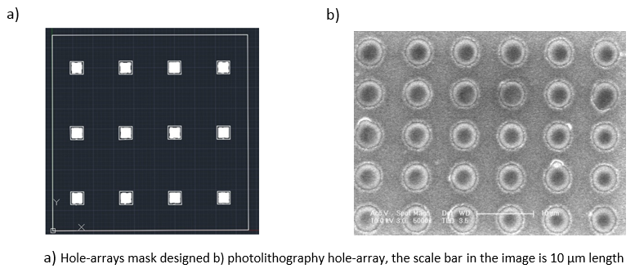
Plasmonic for APD sensor
Sheffiled APD
Colloidal Ga NPs
NPs effect on APD
Plasmonic lens
Plasmonic lens for APD sensor
Hole-array permit the extraordinary optical transmission (EOT) thanks to surface plasmonic polariton resonance (SPPR) and localized surface plasmonic resonance (LSPR) effects. It is possible to take advantage of EOT phenomena to fabricate plasmonic lenses.
Hole-array study by Thompson et al
We are going to investigate the hole-arrays design parameter on different materials like Au, Ga, aluminum zinc oxide (AZO) or zinc nitride.

